Slide 1
Analyzing the Impact of Car Features on Price and Profitability
Shefalika Thapa

Slide 2
PROJECT DESCRIPTION
Over the last few decades, the automotive industry has experienced significant change, with an increasing emphasis on technological innovation, environmental sustainability, and fuel efficiency. Understanding the elements that drive customer demand for cars is now more crucial than ever due to rising manufacturer competition and a changing consumer landscape.
Electric and hybrid vehicles have become more popular in recent years, and interest in alternative fuels like hydrogen and natural gas has also grown. However, traditional gasoline-powered vehicles continue to dominate the market, and buyers have access to a variety of fuel kinds and grades.
The manufacturer could create a pricing strategy that balances consumer demand with profitability and determine which features to concentrate on in future product development efforts by analysing the relationship between a car's features, market category, and pricing and identifying which features and categories are most popular with consumers and most profitable. In the long run, this might help the manufacturing become more profitable and raise its marketability.
Source of Data: Kaggle (by Cooper Union)

Slide 3
APPROACH
Originally, the dataset consisted 11,915 rows and 16 columns.
Null values found in the following columns: Engine Fuel Type(3), Engine HP(69), Engine Cylinder(30), Number of doors(6)
Dropped the rows with null values because these are domain specific columns and imputing them without knowledge might do more harm than good.
Row: 11,098; Columns: 16
Used descriptive statistics, regression analysis, visualization and dashboards.
Limitation: The dataset was last updated in 2017 and after that the trends in automobile industry have largely changed.

Slide 4
TECH STACK USED
Microsoft Excel 2019 is used to perform the analysis as there are 11,098 rows and 16 columns.
The dataset is not huge and can be easily analysed in Excel.
Excel has built in functionalities to run regression analysis and can be used to create interactive charts and dashboards.
Excel file link: https://docs.google.com/spreadsheets/d/1fAghU5Ad745NzZfOkftUMsKAX0My59sz/edit?usp=sharing&ouid=111360395057791388166&rtpof=true&sd=true

Slide 5
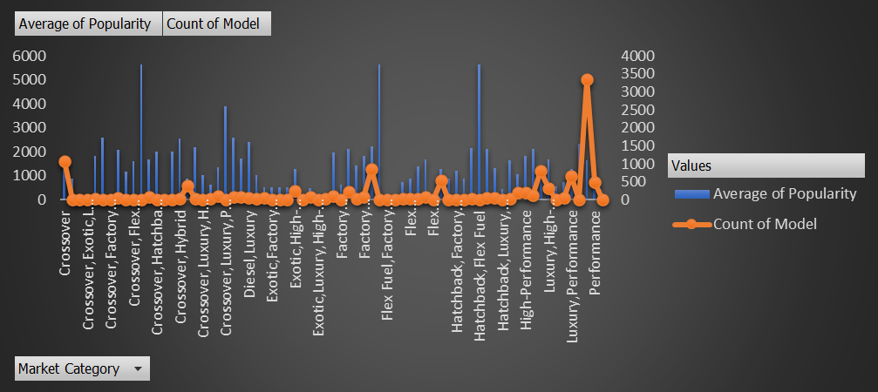
INSIGHT: Popularity of a car model across different market categories
Crossover-Flex Fuel-Performance has highest popularity

Slide 6
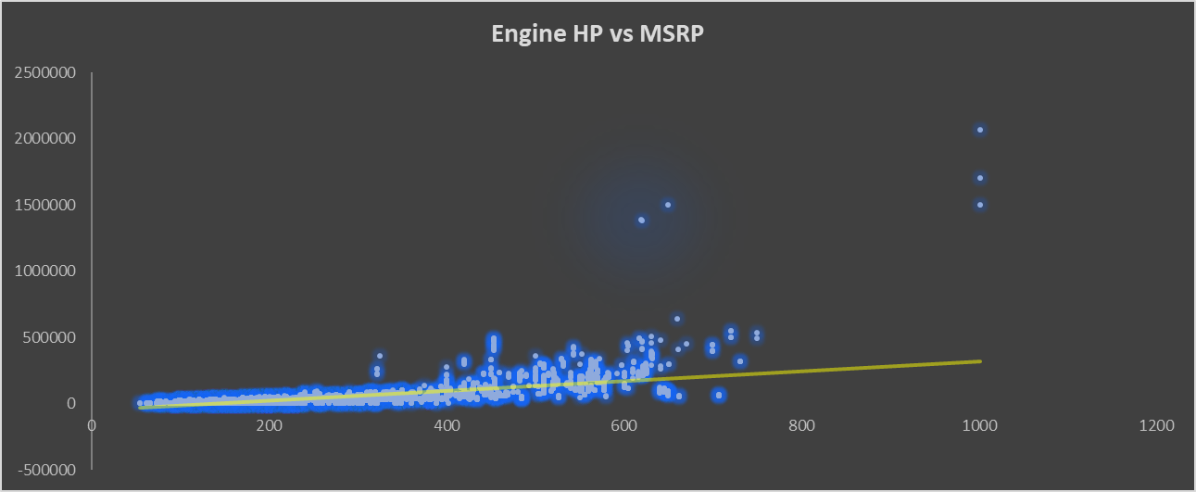
Relationship between car's engine power and its price
Correlation: 0.658983: Car’s price increases as the engine power increases.

Slide 7
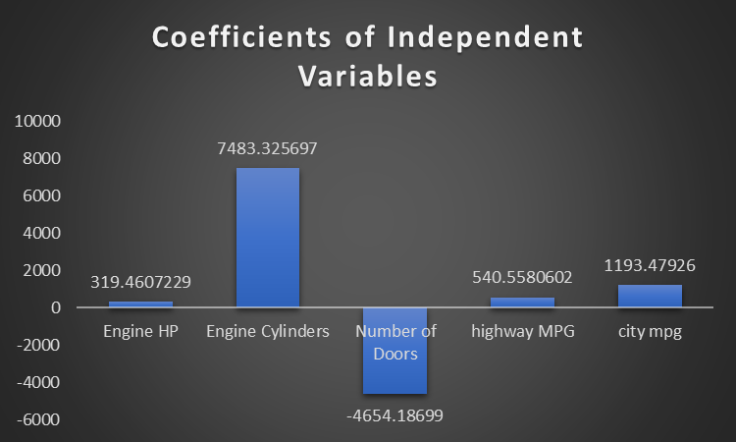
Regression analysis to identify features that have strongest relationship with a car's price
Engine Cylinders have the strongest relationship with a car’s price

Slide 8
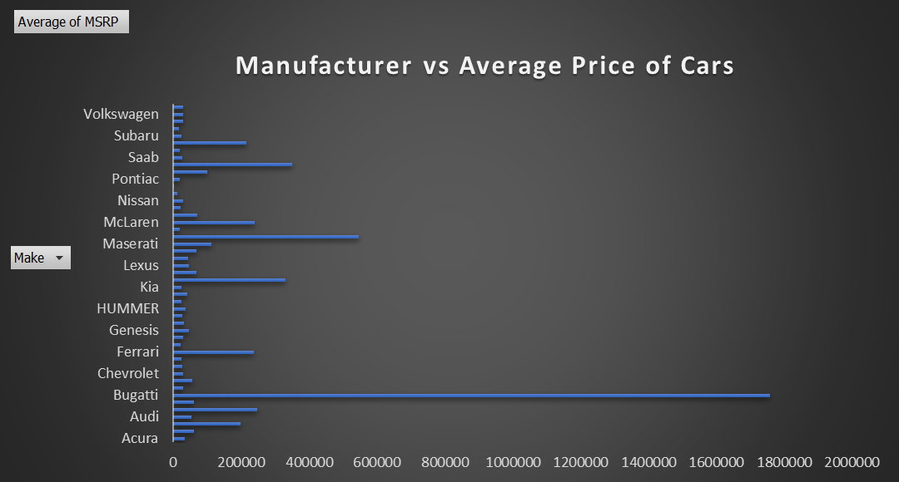
Average price of car across different manufacturers
Bugatti has the highest average price of $1757223.667

Slide 9
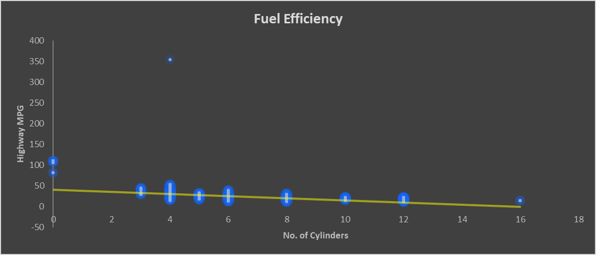
Relationship between fuel efficiency & number of cylinders
A negative correlation of -0.6147 suggests that as the no. of cylinders increase, the efficiency decreases. Optimal efficiency can be seen at 4 as the no. of cylinders

Slide 10
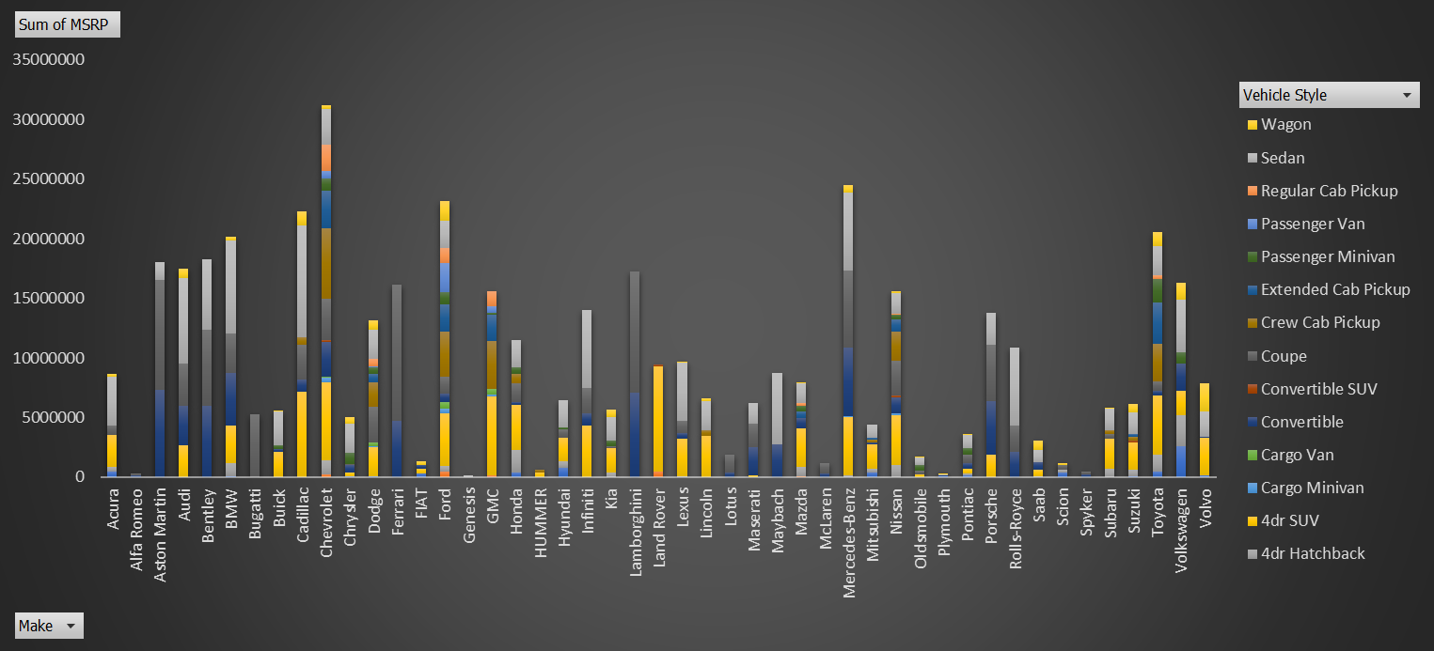
Distribution of car prices by brand & body style
Brand Chevrolet and body style Wagon have the highest percentage in the total sum of prices.

Slide 11
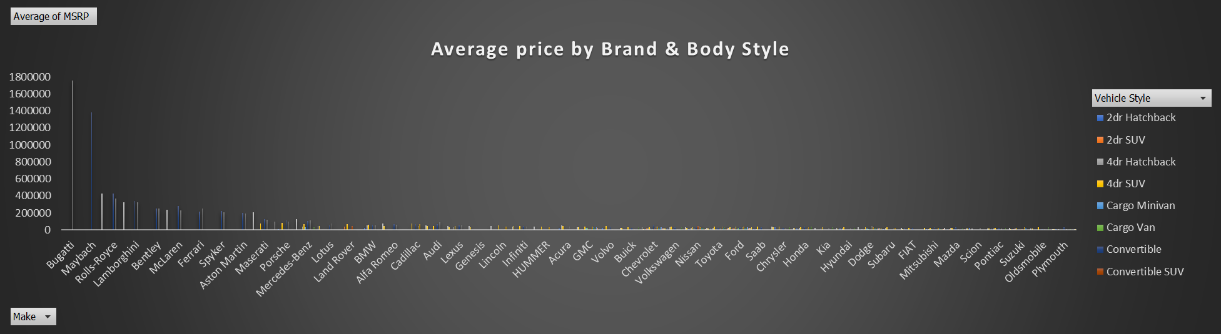
Average Price by Brand and Body Style
Coupe style of Bugatti brand has highest average price & Plymouth has the lowest average price

Slide 12
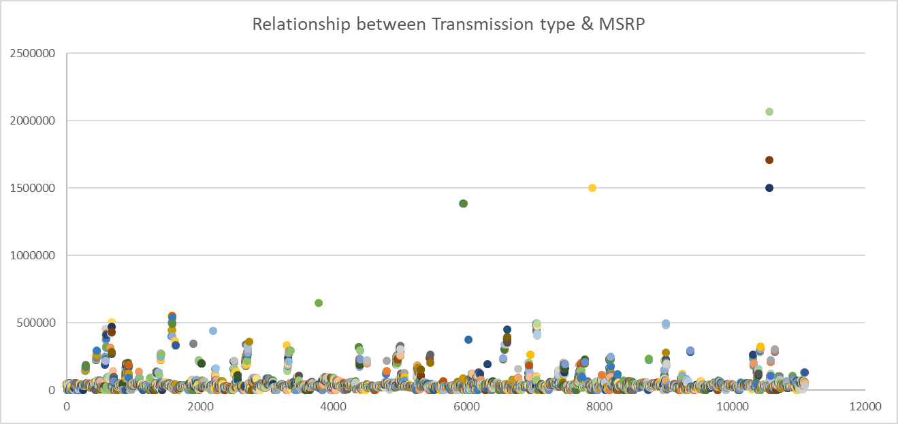
Relationship between Transmission type & MSRP
Automated_Manual Coupe has the highest MSRP

Slide 13
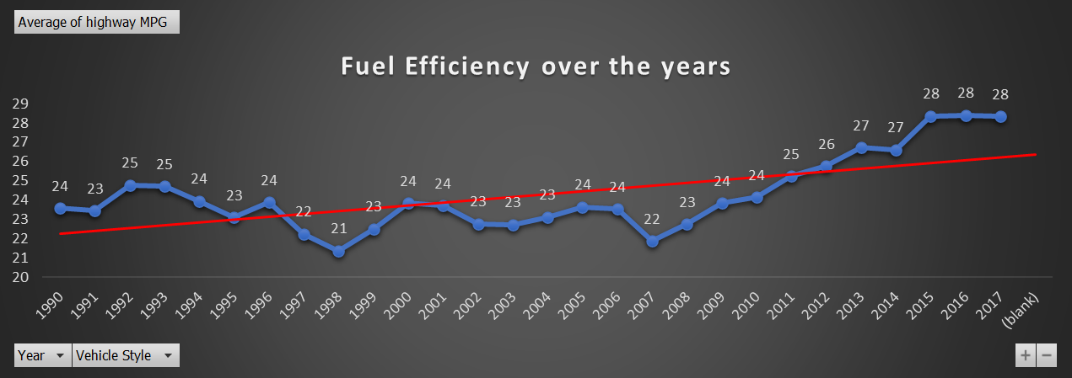
Fuel efficiency across body styles & model years
As the years progressed, fuel efficiency has improved and increased

Slide 14
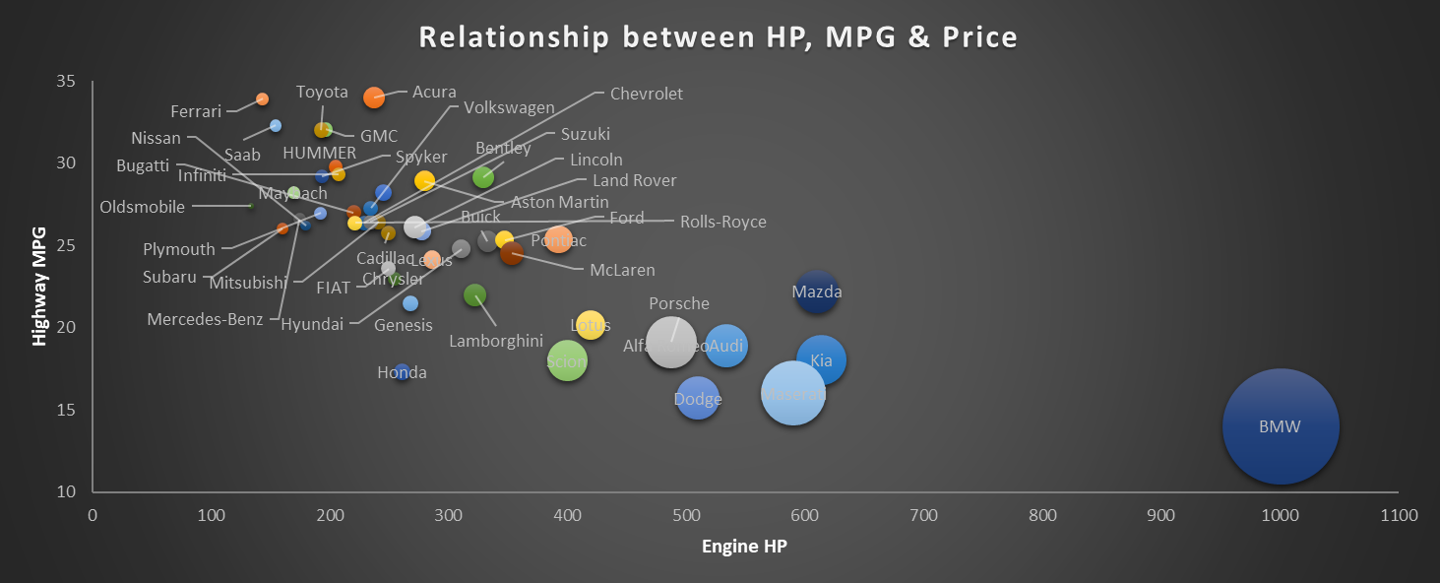
Relationship between Engine HP, MPG & Price
Higher the Engine HP, higher the price range goes. However, Engine HP and Highway MPG don’t show the same trend.

Slide 15
CONCLUSION
The market category of : Crossover-Flex Fuel-Performance has the highest popularity. So, the manufacturers can continue producing the same.
The price of car is directly proportional to the engine power.
Engine cylinders positively influence the car price. Hence, the stakeholders can focus more on this feature than the others.
The brand value of Bugatti is highest, probably because people like luxury cars more.
The manufacturers can be suggested to make cars with less cylinders (ideally 4) as fuel efficiency decreases as the no. of cylinders increase.
Chevrolet wagon style contributes most to the car sales.
Bugatti (Coupe) has the highest average price and Plymouth has the lowest.
Automated manual coupe has the highest price.
The manufacturers have to pay more attention to the fuel efficiency as over the years it has increased consistently.
Engine HP and price are directly related. So, the stakeholders can focus more on engine HP more, making the cars more efficient.

Slide 16
RESULT
With this project, I learnt how to use regression analysis and read the analysis results. I used bubble chart and customized it using various options available.
Making the charts more interactive by using filters and slicers added a new dimension to my analysis. My knowledge on pivot tables was enhanced as I used them for the analysis and drew meaningful conclusions.
Dashboard is an important part of a good data analysis and is crucial for understanding the data at a glance. This project helped me understand the importance of the same.

Slide 17
THANK YOU

